Slide 1
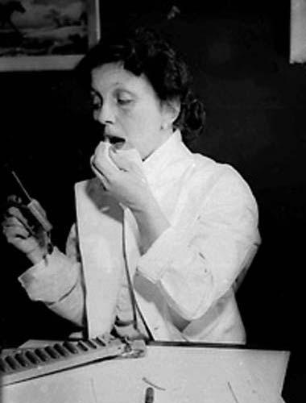
Hazel Bishop
Sarah Follen

Slide 2
Early Life
-Born August 17, 1906 in Hoboken, New Jersey
-Died December 5, 1998
-Education: Barnard College 1929 (Columbia University)
-Hoped to go into medicine
- In 1935, she took a job as an assistant researcher in the Columbia Medical Center.

Slide 3
Early Life Continued
-Worked at Standard Oil Company (1942-1945)
-Worked Socony-Vacuum Oil Company (1945-1950)
-Later in 1948, she founded the Hazel Bishop Corporation with the help of lawyer, Alfred Berg.

Slide 4
Interest of Cosmetics
-During her time at the Medical Center in the 1930s, she also gained some experience with the business of cosmetics.
-She had an interest of lipsticks.
-She wanted to great of form of lipstick that was non drying, non irritating, and long-wearing.

Slide 5
How she did this...
-She did over 300 experiments and finally found one that she thought would work.
- Created a long lasting lipstick with bromo acid dyes to get the acid to last long.
- The main setback was this lipstick caused dryness.
-She tried to use lanolin to offset some of the dryness but did not succeed.
-Long-lasting lipstick was at a decline by the end of the decade.

Slide 6
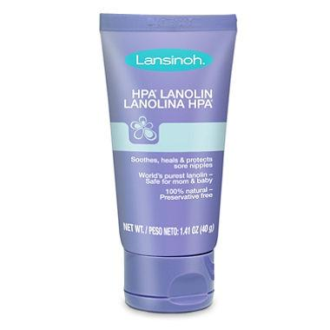
What is lanolin?
-Lanolin is a natural moisturizer.
-It is a fatty substance naturally found on sheep’s wool.
-It is used a base for ointments.

Slide 7
Concerns with the Lipstick
-One major concern with Bishop, was the pigments of her lipstick. She considered them a very important part with her formulation.
-Another concern, was removing the lipstick. Even if soap, water, or cold cream were used the lips will still be stained in the morning.

Slide 8
Different Colors
-Hazel originally had 6 colors of lipstick. These were:
-Pink
-Red Orange
-Real Real Red
-Medium Red
-Secret Red
-Dark Red
-She later added Light Pink and Light Red.

Slide 9
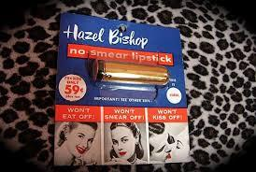
Lipsticks Success
-The lipstick was successfully trialled at
Bishop’s Alma Mater in 1949.
-It then went on sale in 1950.
-It was advertised that the lipstick
will not “eat off, bite off, or kiss off.”
-The introduction of her lipstick seemed to be a success.
-The line sold out in one day.
-Sales made it to $50,000 in 1950, but experienced a small loss to help with national expansion.

Slide 10
Advertising
-Hazel and her company turned
to the help of Raymond Spector
for advertising.
-By 1953, Hazel Bishop sales made
it to 10 million dollars.
-She was also the largest cosmetic
advertiser in the United States.

Slide 11
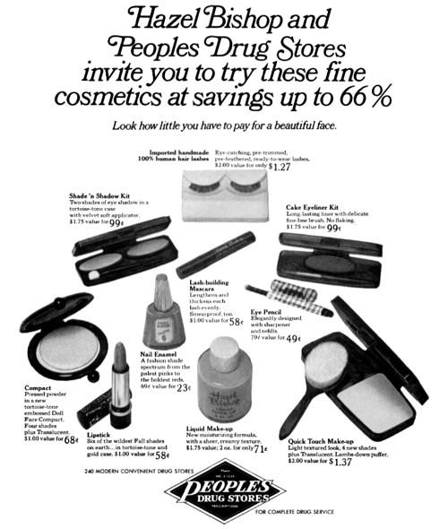
Diversification
-By the end of the 1950s,
the Hazel Bishop company
diversified its product line.
-This line included
foundations, face powders,
hairspray, eye makeup, and perfume.

Slide 12
Catalog Entry
Hazel Bishop: Chemist who invented the first smear proof lipstick.

